Slide 1
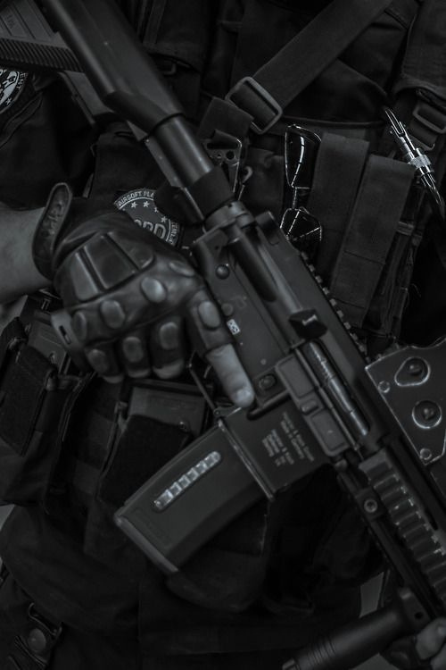

WEAPONS DETECTION FROM BODY-CAM
Hen Golyan
Aviv Heller
Afik Suissa
Generative AI and Computer Vision, semester A

Slide 2
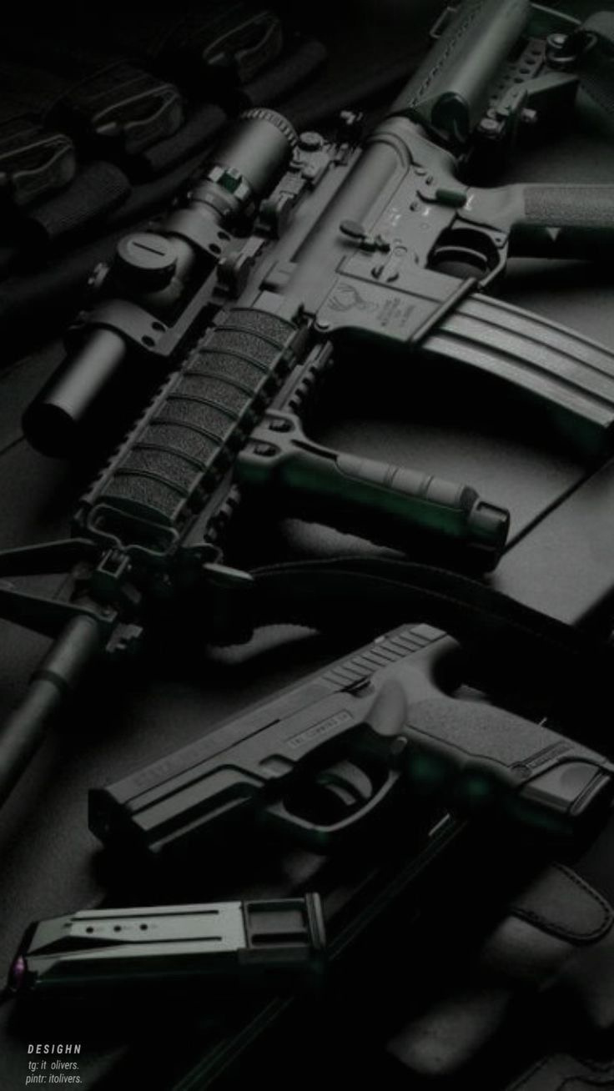
PROJECT REVIEW
Detect weapons from body-worn cameras for military and public safety applications.
Real-time alerts, enhanced situational awareness and efficient post event analysis.
For some images, we applied Bodycam distortions and a 'realism pass’.

Slide 3
PREVIOUS WORK
Article name | About | Relevance | Link
“Using a High-Precision YOLO Surveillance System for Gun Detection to Prevent Mass Shootings” | YOLO based deep learning for real time firearm detection to enhance threat identification and security response. | Provides dataset examples that are closely related to the data used in our project. | https://www.mdpi.com/2673-2688/6/9/198
“Systematic review on weapon detection in surveillance footage through deep learning” | "A review of deep learning methods for real-time weapons detection in security environments. | From this review, we identified which deep learning approaches are most suitable for our project and which are less effective. | https://www.sciencedirect.com/science/article/abs/pii/S1574013723000795
“Effective Strategies for Enhancing Real-Time Weapons Detection in Industry” | Enhancing real-time weapons detection with AI for improved accuracy and small object recognition. | Inspired by this paper for real-time image capture while maintaining quality and features. | https://www.mdpi.com/2076-3417/14/18/8198

Slide 4
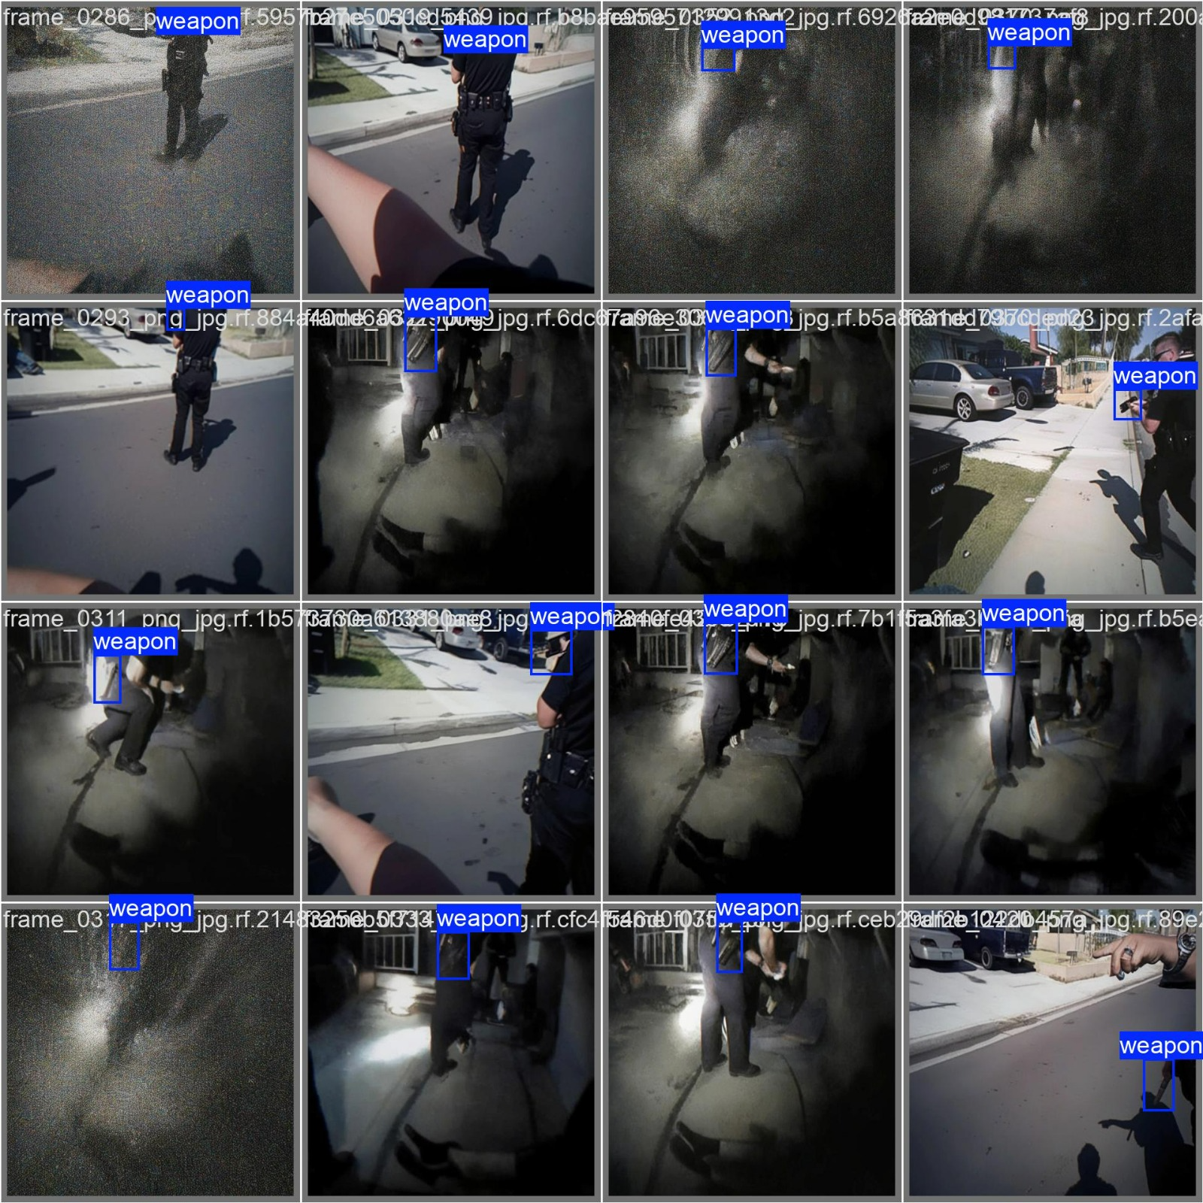
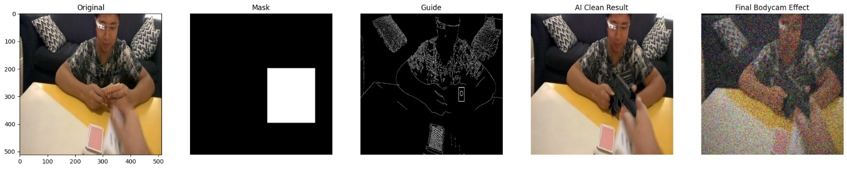
DATASET
Augment existing dataset: introduce distortions to existing surveillance images with already labeled weapons.
Inpainting: use existing FPV footage and in-paint weapons into target locations.
Used: Used Fisheye effect, image distortion augmentation, with Albumentations + OpenCV.
Used: used labeled hand/surgical base photos with inpainting and guidance masks, and applied fisheye distortions and sensor noise to emulate real-world bodycam footage.

Slide 5
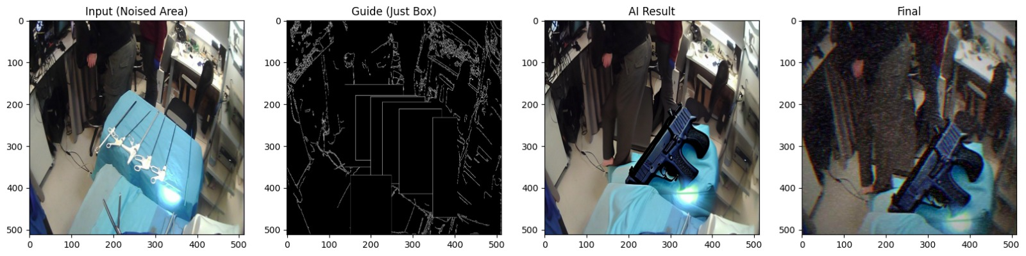
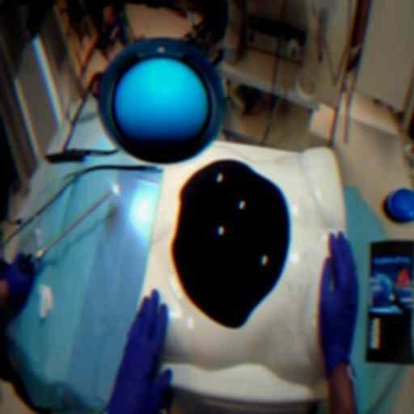
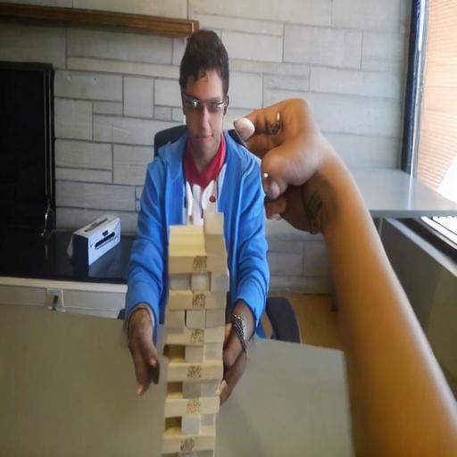
DATASET
Unsuccessful Inpainting photos:

Slide 6
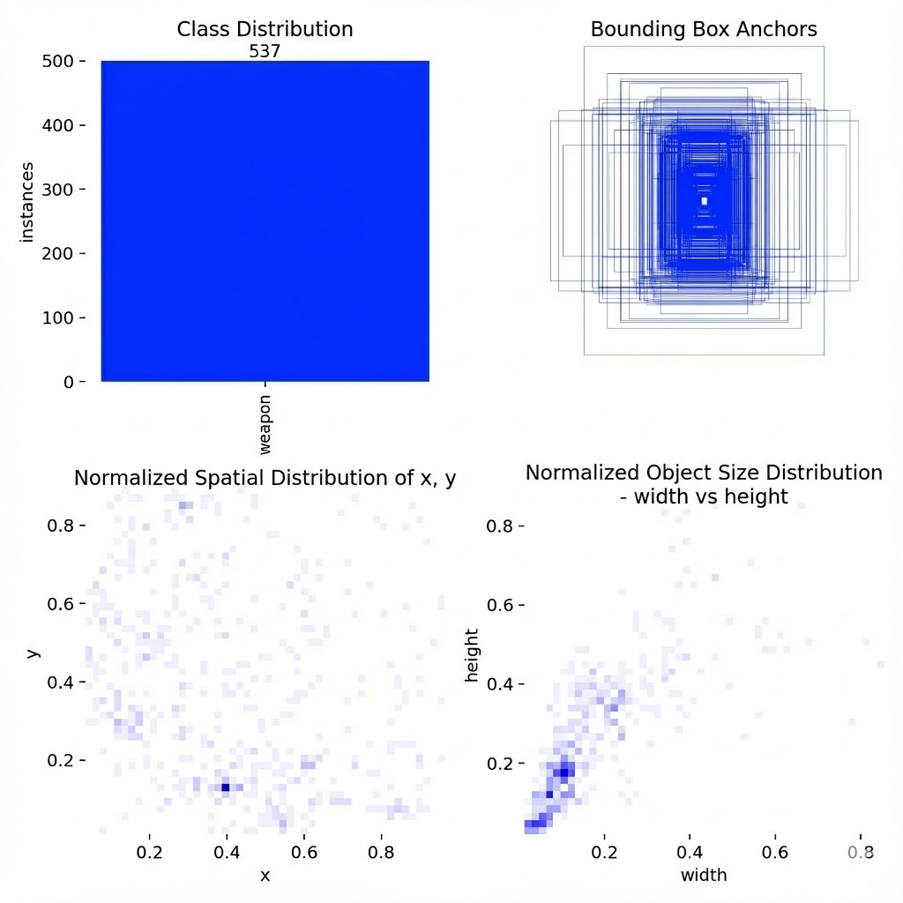
DATASET EDA

Slide 7
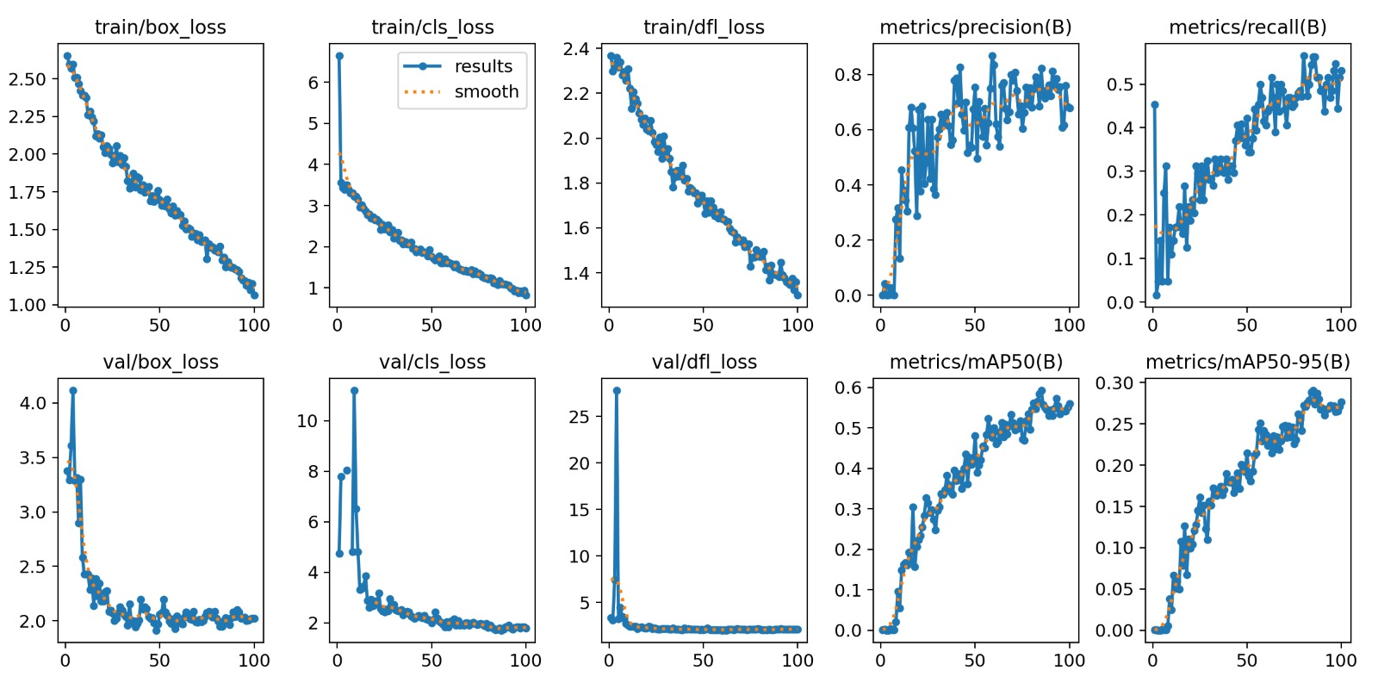
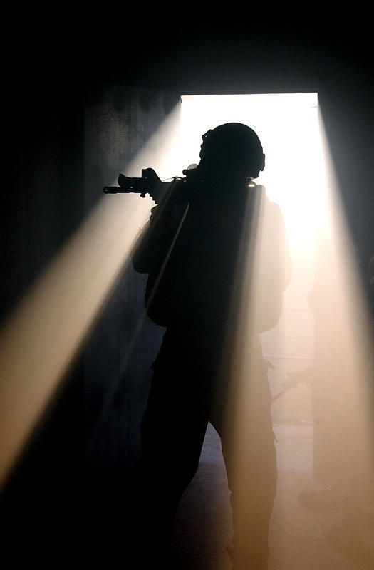
BASELINE SOLUTION AND RESULTS
01
Train metrics

Slide 8
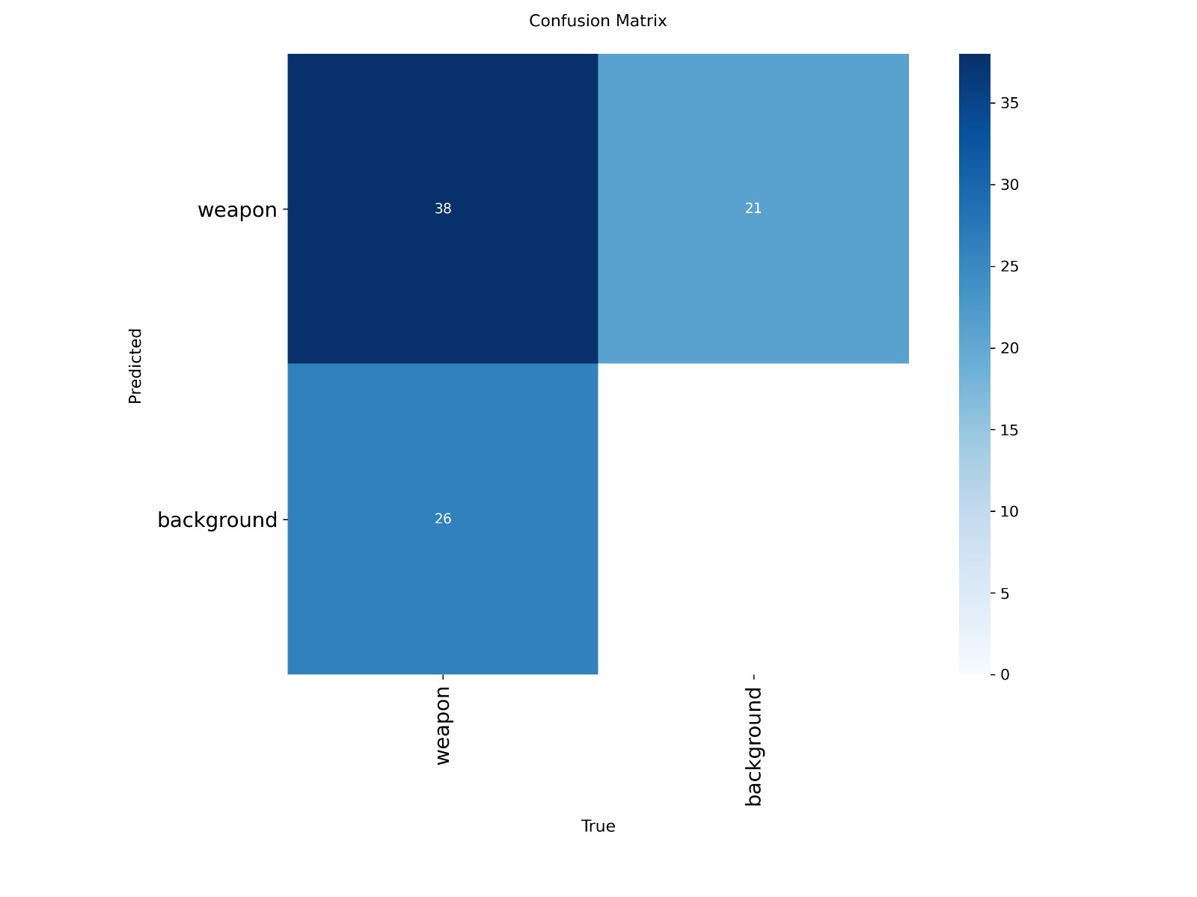
02
Confusion Matrix
44.7% 24.7%
30.6%
BASELINE SOLUTION AND RESULTS
Baseline
Model
Evaluation
Metric | Value
mAP50 | 0.532 (53.2%)
Precision | 0.692 (69.2%)
Recall | 0.508 (50.8%)
Inference Speed | 5.4ms per image (T4 GPU)
03

Slide 9
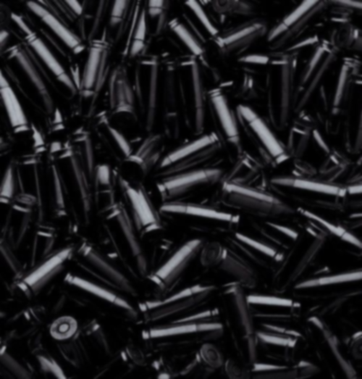
PLAN
Core Model: YOLOv8s (Small)
Hybrid Training Strategy: Combining real-world labeled hand-surgical frames with AI-Generated Synthetic Weapon Data (Diffusion-based inpainting).
Evaluation Metrics: Optimization will focus on balancing Precision (minimizing false alarms) and mAP@.5:.95 (localization accuracy under distortion).
Task/Milestone | Description & Technical Scope | Expected Outcome | Due Date
Phase 2: Synthetic Expansion | Integrating 500+ AI-generated weapon images with specialized prompt guidance. | Diverse dataset with varying lighting & occlusions | Week 10
Phase 3: Hybrid Training | Fine-tuning the YOLOv8 model on the merged (Real + Synthetic) dataset. | Improvement in mAP50 (>60%) and Recall. | Week 11
Phase 4: Optimization | Hyperparameter tuning (learning rate, mosaic augmentation) and model pruning. | A robust, deployment-ready weights file. | Week 12
Phase 5: Final Validation | Testing on unseen "wild" bodycam footage and error analysis. | Final performance report and video demos. | Week 13
Final Preparation | Preparing the final presentation and technical documentation. | Comprehensive Project Submission. | Week 14

